Slide 1
FASTR Workshop - Test Country
January 15-17, 2026** | **Test Country
*Workshop Facilitator*

Slide 2
Workshop Agenda - Day 1
Time | Session | Speaker
8:30 AM - 9:00 AM | Registration
9:00 AM - 9:15 AM | Welcome & Opening Remarks
9:15 AM - 9:45 AM | Participant Introductions
9:45 AM - 10:00 AM | Workshop Objectives
10:00 AM - 10:20 AM | Country Overview
10:20 AM - 10:35 AM | Health Priorities
10:35 AM - 10:50 AM | Tea Break
10:50 AM - 12:05 PM | Introduction to the FASTR Approach
12:05 PM - 12:30 PM | Data Extraction
12:30 PM - 1:30 PM | Lunch
1:30 PM - 2:35 PM | Data Extraction
2:35 PM - 3:30 PM | Group Work & Discussion
3:30 PM - 3:45 PM | Afternoon Tea
3:45 PM - 4:45 PM | Group Work & Discussion
4:45 PM - 5:00 PM | Day Wrap-up & Q&A

Slide 3
Workshop Agenda - Day 2
Time | Session | Speaker
9:00 AM - 9:15 AM | Recap & Questions
9:15 AM - 10:30 AM | Data Quality Assessment
10:30 AM - 10:45 AM | Tea Break
10:45 AM - 11:45 AM | Data Quality Adjustment
11:45 AM - 12:30 PM | Hands-on Practice: DQ Adjust
12:30 PM - 1:30 PM | Lunch
1:30 PM - 3:30 PM | Group Work & Discussion
3:30 PM - 3:45 PM | Afternoon Tea
3:45 PM - 4:45 PM | Group Work & Discussion
4:45 PM - 5:00 PM | Day Wrap-up & Q&A

Slide 4
Workshop Agenda - Day 3
Time | Session | Speaker
9:00 AM - 9:15 AM | Recap & Questions
9:15 AM - 10:15 AM | Data Analysis
10:15 AM - 10:30 AM | Data Analysis
10:30 AM - 10:45 AM | Tea Break
10:45 AM - 11:00 AM | Data Analysis
11:00 AM - 12:30 PM | Hands-on Practice: Analysis
12:30 PM - 1:30 PM | Lunch
1:30 PM - 3:30 PM | Group Work & Discussion
3:30 PM - 3:45 PM | Afternoon Tea
3:45 PM - 4:45 PM | Group Work & Discussion
4:45 PM - 5:05 PM | Next Steps & Action Planning
5:05 PM - 5:20 PM | Day Wrap-up & Q&A

Slide 5
Workshop Objectives
By the end of this workshop, participants will be able to:
• EPI, MCH
• English
• 10
• 4

Slide 6
Country Health System Overview
Test Country

Slide 7
Health System Structure
Level | Description
National | [Ministry of Health]
Regional | [X provinces/regions]
District | [X districts]
Facility | 500 health facilities

Slide 8
Population
Group | Estimate
Total population | 1000000
Women of reproductive age | 200000
Children under 5 | 150000
Expected pregnancies/year | [X per year]
Expected live births/year | [X per year]

Slide 9
Data Sources
Routine data:
• DHIS2 (reporting rate: 80)
Survey data:
• DHIS2 Monthly

Slide 10
Health Priorities
Focus areas for Test Country
• Maternal health services (ANC, skilled birth attendance)
• Child immunization coverage
• Family planning services
• Data quality improvement

Slide 11
☕ Tea Break
15 minutes • Back at 10:50 AM

Slide 12
Introduction to FASTR

Slide 13
What FASTR does with routine HMIS data

Slide 14
Why rapid-cycle analytics?
• Timely insights aligned with country decision cycles
• Continuous learning rather than one-off assessments
• Direct feedback loops between data, analysis, and action

Slide 15
Focus of the analysis
Core indicators
FASTR prioritizes a core set of RMNCAH-N indicators that:
• Represent key service delivery contacts across the continuum of care
• Have relatively high reporting completeness and volumes
• Serve as proxies for broader service delivery performance
Outpatient consultations are included as a proxy for overall health service use. The indicator set can be expanded to reflect country-specific priorities.
Core data quality metrics
Analysis is anchored in a standardized set of data quality metrics, including:
• Reporting completeness
• Extreme value (outlier) detection
• Consistency across related indicators
These metrics are summarized into an overall data quality score to support interpretation and comparison across areas.

Slide 16
FASTR approach to routine data analysis
The FASTR approach follows a three-step workflow:
1. Assess data quality
Identify issues related to completeness, outliers, and internal consistency at national and subnational levels.
2. Adjust for data quality limitations
Apply transparent, indicator-specific corrections to improve the reliability of trend analysis.
3. Analyze service delivery
Quantify changes in priority service volumes and compare coverage trends against country targets.
This enables continuous, subnational monitoring while data quality is systematically improved.

Slide 17
Why extract data from DHIS2?
Data quality adjustment
The FASTR approach focuses on data quality adjustments to expand the analyses countries can do with DHIS2 data and to generate more robust estimates.
The FASTR methodology includes specific approaches to:
• Identify and adjust for outliers
• Adjust for incomplete reporting
• Apply consistent data quality metrics
These adjustments require processing that cannot be done within DHIS2's native analytics.

Slide 18
Tools for data extraction
*Content to be developed*
This section will cover:
• DHIS2 data export options
• API-based extraction methods
• Data transformation requirements
• Quality checks on extracted data

Slide 19
🍽️ Lunch Break
60 minutes • Back at 1:30 PM

Slide 20
Why extract data from DHIS2?
Data quality adjustment
The FASTR approach focuses on data quality adjustments to expand the analyses countries can do with DHIS2 data and to generate more robust estimates.
The FASTR methodology includes specific approaches to:
• Identify and adjust for outliers
• Adjust for incomplete reporting
• Apply consistent data quality metrics
These adjustments require processing that cannot be done within DHIS2's native analytics.

Slide 21
Tools for data extraction
*Content to be developed*
This section will cover:
• DHIS2 data export options
• API-based extraction methods
• Data transformation requirements
• Quality checks on extracted data

Slide 22
☕ Afternoon Tea
15 minutes • Back at 3:45 PM

Slide 23
See You Tomorrow!
Day 1 Complete
We covered today:
• Introduction to the FASTR Approach
• Data Extraction

Slide 24
Tomorrow: Day 2
We resume at **9:00 AM**
**Coming up:** Data Quality Assessment, Data Quality Adjustment

Slide 25
Day 2: Recap & Questions
Yesterday we covered:
• Introduction to the FASTR Approach
• Data Extraction

Slide 26
Questions & Discussion
• Any questions from yesterday's sessions?
• Points that need clarification?
• Insights from the exercises?

Slide 27
Data quality assessment
Understanding the reliability of routine health data

Slide 28
Why talk about data quality?
**The challenge:** Health facilities report data every month, but sometimes:
• Numbers seem too high or too low
• Facilities forget to report
• Related numbers don't match up
**The impact:** Bad data leads to bad decisions
• We might think services are improving when they're not
• We might miss real problems in certain areas
• Resources might go to the wrong places
**FASTR's solution:** Check data quality systematically, fix what we can, and be transparent about limitations

Slide 29
Three simple questions about data quality
1. Are facilities reporting regularly?
• Completeness: Did we get reports from facilities this month?
2. Are the numbers reasonable?
• Outliers: Are there any suspiciously high values?
3. Do related numbers make sense together?
• Consistency: Do related services show expected patterns?
These three questions help us understand if we can trust the data for decision-making.

Slide 30
Question 1: Are facilities reporting?

Slide 31
Completeness: Did we get reports?
What we're checking:
Each month, are facilities sending in their reports?
Example:
• District has 20 health centers
• In March, only 15 sent ANC data
• Completeness = 75% (15 out of 20 reported)
Why it matters:
• If many facilities don't report, we're missing part of the picture
• Trends might look like services dropped, when really facilities just didn't report

Slide 32
What's good completeness?
It depends on your health system:
• 90%+ is excellent
• 80-90% is good
• Below 80% means we're missing a lot of information
**Important:** Even 100% completeness doesn't mean we have the full picture - some services might happen outside facilities or some facilities might not be in the reporting system.
**What to look for:** Is completeness improving over time? Which areas have low completeness?

Slide 33
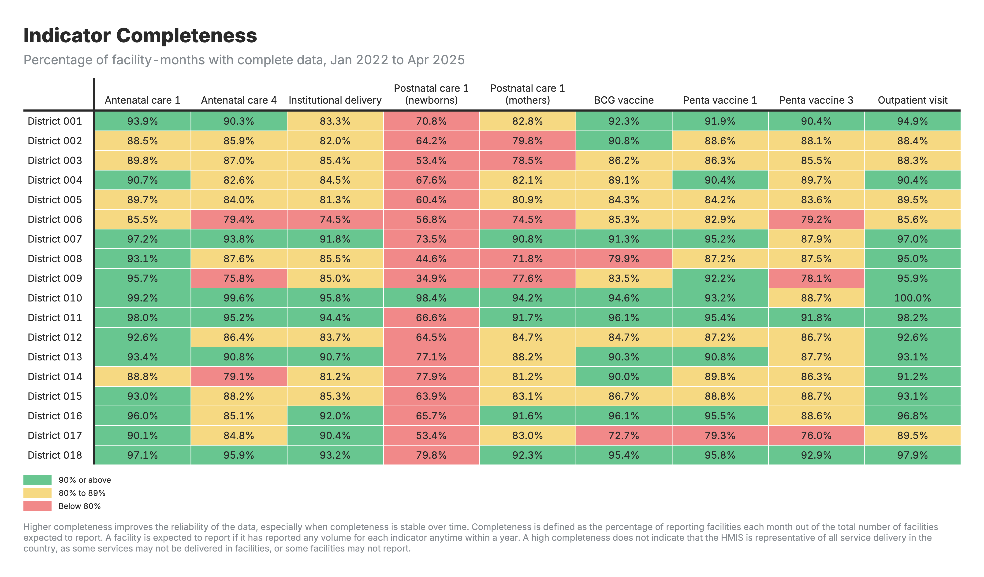
Completeness: FASTR output

Slide 34
Question 2: Are numbers reasonable?

Slide 35
Outliers: Spotting suspicious numbers
What we're checking:
Are there any values that seem way too high compared to what that facility normally reports?
Real example:
• Health Center A normally reports 20-25 deliveries per month
• In March, they reported 450 deliveries
• This is likely a data entry error (maybe they typed an extra digit, or reported cumulative instead of monthly)
Why it matters:
• One extreme value can make it look like there was a huge service increase
• Skews totals and trends for the whole district or province

Slide 36
How we spot outliers
Outliers are identified by assessing the within-facility variation in monthly reporting for each indicator.
A value is flagged as an outlier if it meets EITHER of two criteria:
• A value greater than 10 times the Median Absolute Deviation (MAD) from the monthly median value for the indicator, OR
• A value for which the proportional contribution in volume for a facility, indicator, and time period is greater than 80%
AND for which the count is greater than 100.

Slide 37
Outlier example
Month | Tests Reported | Normal?
January | 245 | Normal
February | 267 | Normal
March | 2,890 | Outlier
April | 256 | Normal

Slide 38
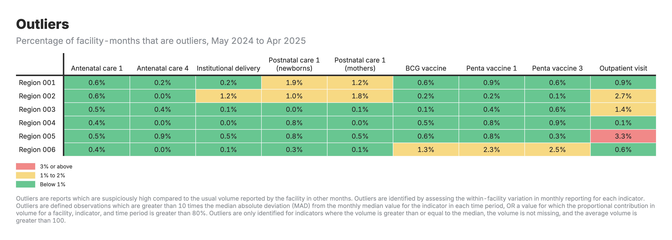
Outliers: FASTR output

Slide 39
Question 3: Do related numbers match up?

Slide 40
Consistency: Do related services make sense together?
What we're checking:
Health services are related - certain patterns are expected.
Example 1 - ANC visits:
• More women should get their 1st ANC visit (ANC1)
• Fewer should complete all 4 visits (ANC4)
• We expect: ANC1 >= ANC4
Example 2 - Vaccinations:
• More babies should get their 1st Penta dose (Penta1)
• Fewer should complete all 3 doses (Penta3)
• We expect: Penta1 >= Penta3
If these relationships are backwards, something's wrong with the data.

Slide 41
Why check consistency at district level?
Patients move between facilities:
• Woman might get ANC1 at Health Center A
• But deliver at District Hospital B
• If we only look at each facility separately, numbers might not match
**Solution:** Check consistency at district level
• Add up all ANC1 visits in the district
• Add up all ANC4 visits in the district
• Compare the totals
This accounts for patients visiting different facilities for different services.

Slide 42
Consistency example
Indicator | District Total | Expected Relationship
ANC1 | 5,200 visits | Should be higher
ANC4 | 4,100 visits | Should be lower

Slide 43
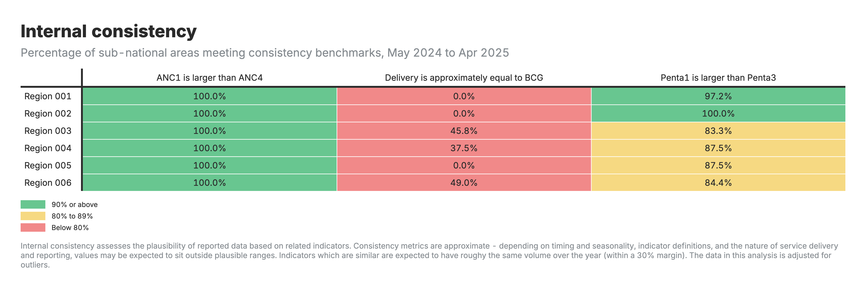
Consistency: FASTR output

Slide 44
Putting it all together: Overall data quality

Slide 45
Overall quality score
For each facility and month, we combine all three checks:
**Complete:** Did the facility report?
**No outliers:** Are the numbers reasonable?
**Consistent:** Do related numbers make sense?
Binary DQA Score:
• dqa_score = 1 if all consistency pairs pass
• dqa_score = 0 if any consistency pair fails
**DQA Mean:** Average of completeness-outlier score and consistency score
This score helps us:
• Decide which data to use for analysis
• Identify facilities that need support
• Track if data quality is improving over time

Slide 46
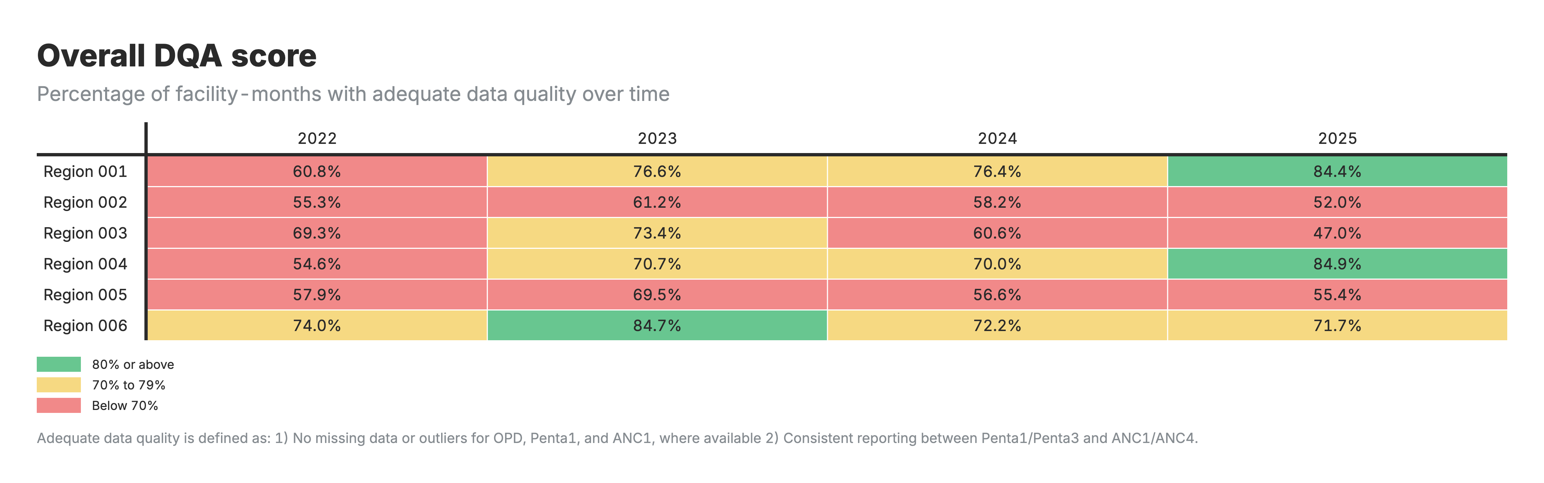
Overall DQA score: FASTR output

Slide 47
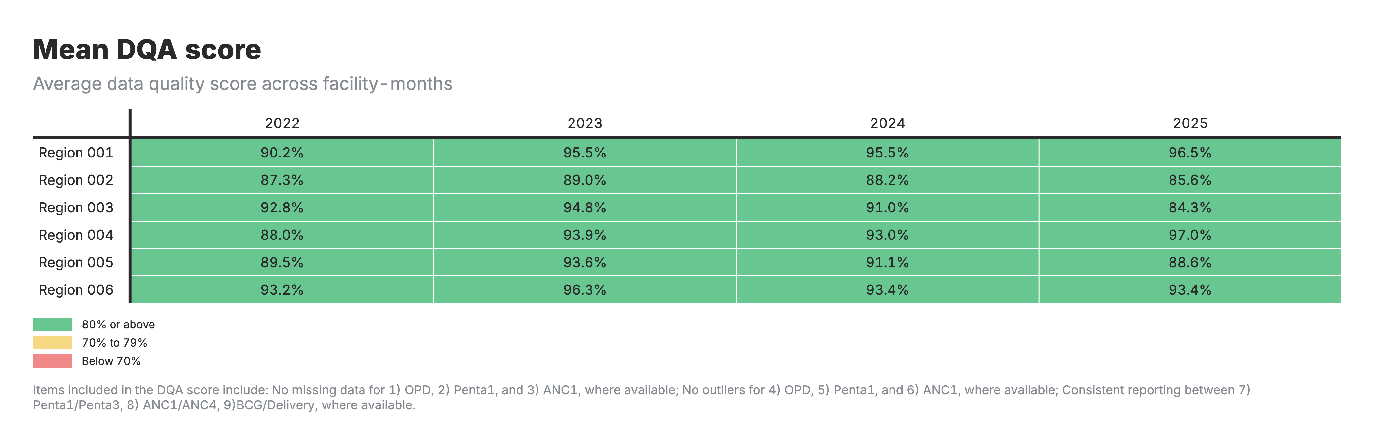
Mean DQA score: FASTR output

Slide 48
☕ Tea Break
15 minutes • Back at 10:45 AM

Slide 49
Approach to data quality adjustment
The Data Quality Adjustment module (Module 2 in the FASTR analytics platform) systematically corrects two common problems in routine health facility data:
• Outliers - extreme values caused by reporting errors or data entry mistakes
• Missing data - from incomplete reporting
Rather than simply deleting problematic data, this module replaces questionable values with statistically sound estimates based on each facility's own historical patterns.

Slide 50
Four adjustment scenarios
Scenario | Description
None | Original data, no adjustments
Outliers only | Only outlier corrections applied
Completeness only | Only missing data filled in
Both | Both types of corrections applied

Slide 51
Adjustment for outliers
For each value flagged as an outlier, the module calculates what the value "should have been" based on that facility's historical pattern.
Methods used (in order of preference):
• Centered 6-month rolling average (3 months before + 3 months after)
• Forward 6-month rolling average
• Backward 6-month rolling average
• Same month from the previous year (for seasonal indicators)
• Facility-specific historical mean (fallback)

Slide 52
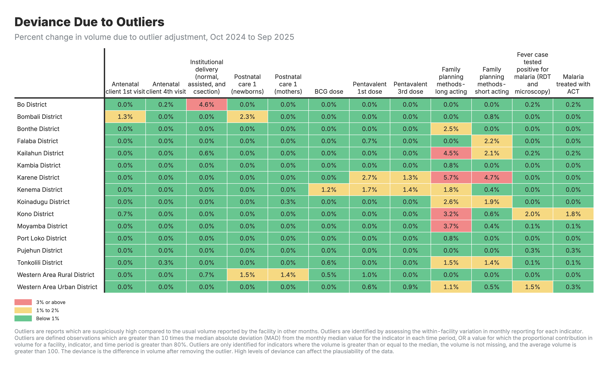
Outlier adjustment: FASTR output

Slide 53
Adjustment for completeness
For months where data is missing or marked as incomplete, the module imputes (fills in) values using the same rolling average approach.
This ensures that temporary reporting gaps don't create artificial drops to zero in the data.

Slide 54
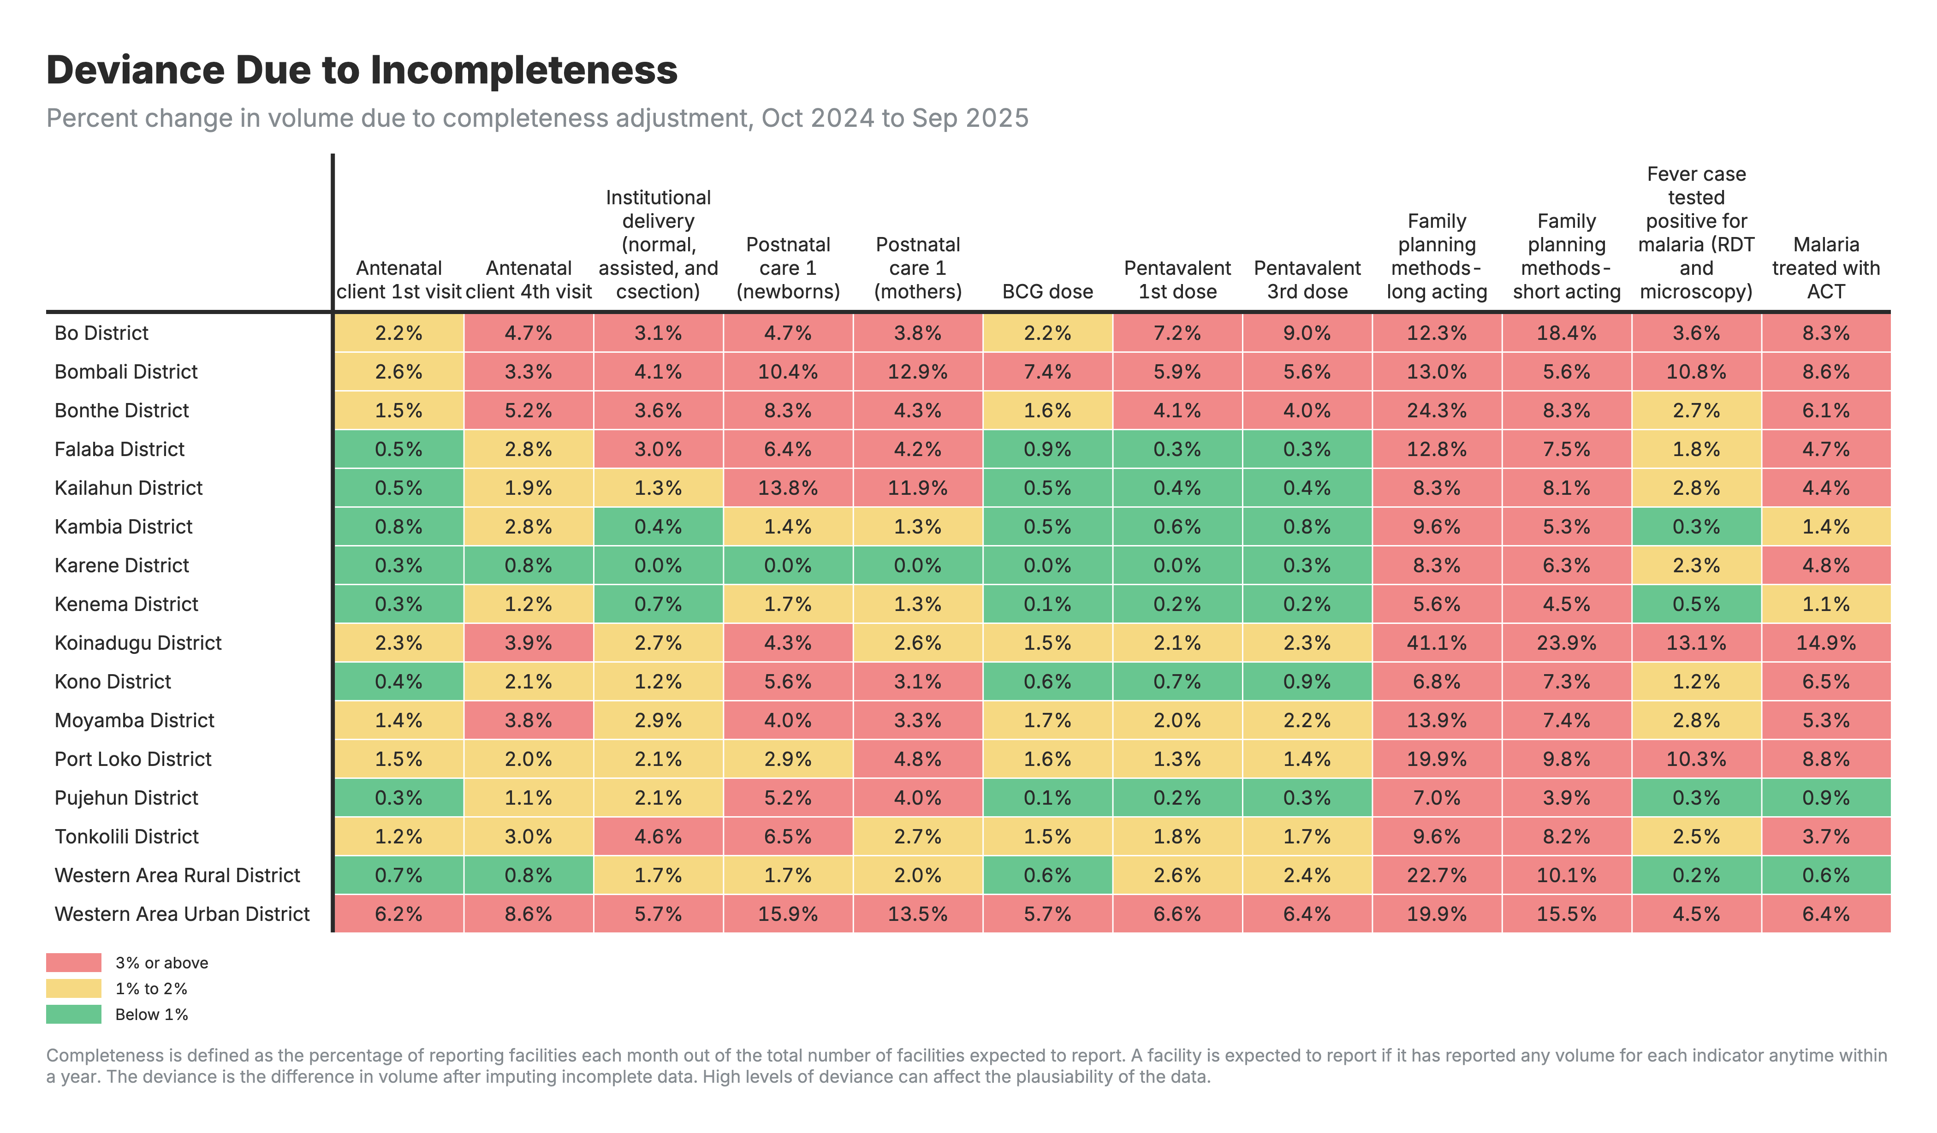
Completeness adjustment: FASTR output

Slide 55
🍽️ Lunch Break
60 minutes • Back at 1:30 PM

Slide 56
☕ Afternoon Tea
15 minutes • Back at 3:45 PM

Slide 57
See You Tomorrow!
Day 2 Complete
We covered today:
• Data Quality Assessment
• Data Quality Adjustment

Slide 58
Tomorrow: Day 3
We resume at **9:00 AM**
**Coming up:** Data Analysis

Slide 59
Day 3: Recap & Questions
Yesterday we covered:
• Data Quality Assessment
• Data Quality Adjustment

Slide 60
Questions & Discussion
• Any questions from yesterday's sessions?
• Points that need clarification?
• Insights from the exercises?

Slide 61
Service utilization analysis
The Service Utilization module (Module 3 in the FASTR analytics platform) analyzes health service delivery patterns to detect and quantify disruptions in service volumes over time.
Key capabilities:
• Identifies when health services deviate significantly from expected patterns
• Measures magnitude of disruptions at national, provincial, and district levels
• Distinguishes normal fluctuations from genuine disruptions requiring investigation

Slide 62
Two-stage analysis process
Part 1: Control chart analysis
• Model expected patterns using historical trends and seasonality
• Detect significant deviations from expected volumes
• Flag disrupted periods
Part 2: Disruption quantification
• Use panel regression to estimate service volume changes
• Calculate shortfalls and surpluses in absolute numbers

Slide 63
Surplus and disruption analyses
Disruption Type | Description
Sharp disruptions | Single months with extreme deviations
Sustained drops | Gradual declines over several months
Sustained dips | Periods consistently below expected levels
Sustained rises | Periods consistently above expected levels
Missing data patterns | Gaps in reporting that may signal problems

Slide 64
Quantifying impact
Disruption analysis quantifies shortfalls and surpluses by comparing:
• Predicted volumes (what would have happened without disruption)
• Actual volumes (what was observed)
Results are reported in absolute numbers and percentages at each geographic level.

Slide 65
Service Coverage Estimates
This module estimates health service coverage by answering: **"What percentage of the target population received this health service?"**
Three data sources integrated:
• Adjusted health service volumes from HMIS
• Population projections from United Nations
• Household survey data from MICS/DHS

Slide 66
Two-Part Process
Part 1: Denominator Calculation
• Calculate target populations using multiple methods (HMIS-based and population-based)
• Compare against survey benchmarks
• Automatically select best denominator for each indicator
Part 2: Coverage Estimation
• Override automatic selections based on programmatic knowledge
• Project survey estimates forward using HMIS trends
• Generate final coverage estimates

Slide 67
Service utilization analysis
The Service Utilization module (Module 3 in the FASTR analytics platform) analyzes health service delivery patterns to detect and quantify disruptions in service volumes over time.
Key capabilities:
• Identifies when health services deviate significantly from expected patterns
• Measures magnitude of disruptions at national, provincial, and district levels
• Distinguishes normal fluctuations from genuine disruptions requiring investigation

Slide 68
Two-stage analysis process
Part 1: Control chart analysis
• Model expected patterns using historical trends and seasonality
• Detect significant deviations from expected volumes
• Flag disrupted periods
Part 2: Disruption quantification
• Use panel regression to estimate service volume changes
• Calculate shortfalls and surpluses in absolute numbers

Slide 69
Surplus and disruption analyses
Disruption Type | Description
Sharp disruptions | Single months with extreme deviations
Sustained drops | Gradual declines over several months
Sustained dips | Periods consistently below expected levels
Sustained rises | Periods consistently above expected levels
Missing data patterns | Gaps in reporting that may signal problems

Slide 70
Quantifying impact
Disruption analysis quantifies shortfalls and surpluses by comparing:
• Predicted volumes (what would have happened without disruption)
• Actual volumes (what was observed)
Results are reported in absolute numbers and percentages at each geographic level.

Slide 71
Service Coverage Estimates
This module estimates health service coverage by answering: **"What percentage of the target population received this health service?"**
Three data sources integrated:
• Adjusted health service volumes from HMIS
• Population projections from United Nations
• Household survey data from MICS/DHS

Slide 72
Two-Part Process
Part 1: Denominator Calculation
• Calculate target populations using multiple methods (HMIS-based and population-based)
• Compare against survey benchmarks
• Automatically select best denominator for each indicator
Part 2: Coverage Estimation
• Override automatic selections based on programmatic knowledge
• Project survey estimates forward using HMIS trends
• Generate final coverage estimates

Slide 73
☕ Tea Break
15 minutes • Back at 10:45 AM

Slide 74
Service utilization analysis
The Service Utilization module (Module 3 in the FASTR analytics platform) analyzes health service delivery patterns to detect and quantify disruptions in service volumes over time.
Key capabilities:
• Identifies when health services deviate significantly from expected patterns
• Measures magnitude of disruptions at national, provincial, and district levels
• Distinguishes normal fluctuations from genuine disruptions requiring investigation

Slide 75
Two-stage analysis process
Part 1: Control chart analysis
• Model expected patterns using historical trends and seasonality
• Detect significant deviations from expected volumes
• Flag disrupted periods
Part 2: Disruption quantification
• Use panel regression to estimate service volume changes
• Calculate shortfalls and surpluses in absolute numbers

Slide 76
Surplus and disruption analyses
Disruption Type | Description
Sharp disruptions | Single months with extreme deviations
Sustained drops | Gradual declines over several months
Sustained dips | Periods consistently below expected levels
Sustained rises | Periods consistently above expected levels
Missing data patterns | Gaps in reporting that may signal problems

Slide 77
Quantifying impact
Disruption analysis quantifies shortfalls and surpluses by comparing:
• Predicted volumes (what would have happened without disruption)
• Actual volumes (what was observed)
Results are reported in absolute numbers and percentages at each geographic level.

Slide 78
Service Coverage Estimates
This module estimates health service coverage by answering: **"What percentage of the target population received this health service?"**
Three data sources integrated:
• Adjusted health service volumes from HMIS
• Population projections from United Nations
• Household survey data from MICS/DHS

Slide 79
Two-Part Process
Part 1: Denominator Calculation
• Calculate target populations using multiple methods (HMIS-based and population-based)
• Compare against survey benchmarks
• Automatically select best denominator for each indicator
Part 2: Coverage Estimation
• Override automatic selections based on programmatic knowledge
• Project survey estimates forward using HMIS trends
• Generate final coverage estimates

Slide 80
🍽️ Lunch Break
60 minutes • Back at 1:30 PM

Slide 81
☕ Afternoon Tea
15 minutes • Back at 3:45 PM

Slide 82
Next Steps
Action items
• Apply FASTR methods to your country data
• Share findings with stakeholders
• Establish regular data review processes
• Identify areas for data quality improvement

Slide 83
Thank You!
Questions & Discussion

Slide 84
Contact Information
FASTR Team
📧 Email: fastr@worldbank.org
🌐 Website: https://fastr.org

